Slide 1
Various computing models:
Total cost of ownership analysis

Slide 2









Summary
Alternative computing models
 | Terminal/ Presentation server | Typically managed rich desktop | Virtual hosted desktop | Well-managed OS streaming/vPro | Blade PC desktop | Well-managed application streaming/vPro
Deployment ($ = more cost = bad) | $$$$ | $ | $$$$ | $$$ | $$$$$$ | $$$
Power ($ = more cost = bad) | $ | $$$ | $$ | $$$ | $$$$ | $$$
Manageability ($ = more cost = bad) | $$ | $$$$$$ | $$ | $$ | $ | $$$
Productivity/User experience ($ = more cost = bad) | $$$ |  | $$$² | $ | $$$$$$
Total cost ($ = more cost = bad) | $$$$ | $$$ | $$$$^{1,2} | $$ | $$$$$$ | $$
Security (more * = more secure = good) | **** | * | **** | ***** | *** | ****
Future proofing/ Rich application support (more * = more flexibility = good) | ** | **** | *** | **** | * | *****
Desk-side environmental (more * = more comfort = good) | **** | ** | **** | ** | **** | **
Compliance (more * = more compliant = good) | ***** | * | **** | **** | **** | ****
Performance (more * = good) | *** | ***** | Not Tested | **** | *** | *****
Mobility (more * = good) | * | **** | * | * | * | *****
Access infrastructure Clients per server | 57 | n/a | 36¹ | 153 | n/a | 399
TCO scaling (50/100/500/5K/10K users)
Platforms we tested | Citrix Presentation Server to thin client | Typically managed rich client | VMware-based VDI to thin client | Ardence to rich client with Intel vPro technology | HP CCI to thin client | AppStream to rich client with Intel vPro technology
TCO
¹We used lab test results to estimate the number of clients per access infrastructure server for all models except Virtual hosted desktop. For the Virtual hosted desktop model, we used a weighted average of the values from VMware Infrastructure 3 VDI Server Sizing and Scaling (http://www.vmware.com/pdf/vdi_sizing_vi3.pdf).
  ²We used lab test results to estimate the lost productivity for all models except Virtual hosted desktop. We estimated the lost productivity of the Virtual hosted desktop
All thin clients were Wyse Winterm v50. All rich clients were Intel DQ965GF vPro systems. We considered the vPro-specific capabilities, such as those related to management and security, of the DQ965GF system only in the Well-managed cases. In our performance tests, all of the rich clients benefited from the Core 2 Duo processor’s performance.
We assumed the cost and performance of common application servers, such as those providing file, email, database, network services (DNS, Active Directory), and Web services would be the same across all models.
Dollar signs indicate relative computing model costs, with more dollar signs for more costly solutions. Stars indicate relative solution quality, with more stars indicating higher quality.
Go to Conclusions
Go to Key findings
Go to Assumptions
Go to Vista migration
Go to WAN impact

Slide 3
Conclusions
Various computing models: Total cost of ownership analysis
Conclusions
  We found that server-side models may be an appropriate solution for task workers or in places where security or centralized management requirements vastly dominate other factors. However, productivity and mobility considerations can quickly outweigh these issues where knowledge or power users are concerned.
  Well-managed rich clients supported by third-party manageability software provide the greatest benefit for the lowest costs. The additional management and security capabilities of Intel vPro technology extend that advantage. Combining well-managed rich clients with application streaming and/or OS streaming can provide the benefits of server-side computing models without significant loss of end-user productivity and result in a lower cost of ownership.
Go to Key findings
Go to Assumptions
Go to Vista migration
Go to WAN impact

Slide 4
Key findings
Various computing models: Total cost of ownership analysis
Key findings for comparison categories
T C O | Deployment | The Blade PC desktop and server-side computing models have significantly higher deployment costs than the rich client computing models.
 | Power | The Terminal/Presentation server model has the lowest power costs. Power costs for all models however, account for only a small fraction of the overall TCO.
 | Manageability | Manageability costs are lowest with server-side and Blade PC desktop computing models.
 | Productivity/ User experience | The shared nature of server-side platforms and the slow nature of Blade PCs hinder user experience and productivity, particularly in the case of knowledge or power users. Combining well-managed rich clients with application streaming and/or OS streaming can provide all the benefits of server-side computing models without significantly affecting productivity. Productivity loss can be significant for knowledge or power users on server-side and Blade PC desktop models. Because lost user productivity can easily be higher than any of the other costs in this analysis, enterprises need to consider those costs carefully.
 | Total cost | TCO is the sum of acquisition costs and sustaining costs. TCO for server-side and Blade PC desktop computing models is higher than for client-side computing models primarily due to deployment costs and productivity losses.
Security |  | All other platforms we examined offer considerable security improvements over Typically managed rich desktops.
Future proofing/ rich application support |  | Client-side computing models based on rich desktops and notebooks offer significant future-proofing benefits over server-side and Blade PC desktop models. Notably, server-side models offer limited multimedia and rich collaboration support as well as limited Flash-based Internet usage.
Desk-side environmental |  | Smaller and usually cooler and quieter than rich clients, thin clients used in server-side and Blade PC desktop models have less of an impact on the desk-side environment.
Compliance |  | All other computing models we examined offer significant compliance benefits over Typically managed rich desktops.
Performance |  | Client-side computing models showed impressive performance gains over server-side and Blade PC desktop models in our tests.
Mobility |  | True mobility support is available only with the application streaming computing model.
Go to Conclusions
Go to Assumptions
Go to Vista migration
Go to WAN impact

Slide 5
Assumptions
Assumptions
Our example enterprise is evaluating a change from its current typically managed rich computing model. We list here our main assumptions about factors that influence TCO for the example enterprise used in this analysis:
  Enterprise is considering whether to change from current typically managed rich computing model for 10,000 users.
  All users are in one location or campus.
  Only one user uses each client.
  All workers are knowledge workers.
  All clients are at the end of their current refresh cycle and due to be replaced.
  IT anticipates a four-year refresh cycle for the selected computing model.
  All users require a desktop solution, although the enterprise wants a solution that can expand to include mobile users as well.
  The 10,000 users run 120 applications including standard office applications. The users are well trained in the current applications, and IT hopes to transfer all applications to the selected computing model.
  Average burdened worker hourly rate is $40.82; average burdened IT hourly rate is $63.27.
  The enterprise is in the United States, and values represent US dollars.
  TCO analysis should consider deployment costs, manageability costs including user downtime, power costs, and possibly costs of lost user productivity due to platform slowness.
  Servers and Blade PCs (for Blade PC Desktop solution) and support staff are in single location separate from the 10,000 users’ location.
  IT wants to retain the current client and server operating systems.
Go to Conclusions
Go to Key findings
Go to Vista migration
Go to WAN impact

Slide 6
Deployment costs – Overview
DEPLOYMENT COSTS — Overview
Deployment costs are the one-time costs needed to configure the data center and workspaces to use the client type in question. We looked at the following costs:
  Per-client seat costs, including client hardware and licenses
  Server costs, including racks, hardware, and software
  Access infrastructure costs, including additional storage and management software
  Physical costs, such as additional wiring
  Implementation and planning costs for both internal staff and consultants
  Training for both end users and IT staff
  The cost of porting or replacing applications

Slide 7
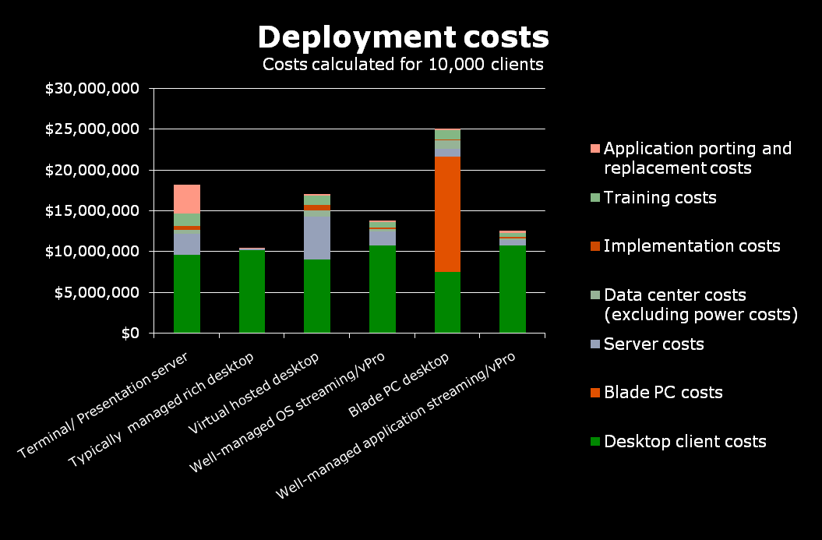
Deployment costs
The Blade PC desktop and server-side computing models have significantly higher deployment costs than the rich client computing models.
Deployment costs are the one-time costs needed to configure the data center and workspaces.
 | Terminal/ Presentation server | Typically managed rich desktop | Virtual hosted desktop | Well-managed OS streaming/ vPro | Blade PC desktop | Well-managed application streaming/vPro
Desktop client costs | $9,660,900 | $10,199,900 | $9,081,400 | $10,739,900 | $7,523,400 | $10,774,900
Blade PC costs | $0 | $0 | $0 | $0 | $14,075,500 | $0
Server costs | $2,486,040 | $171,870 | $5,212,056 | $1,763,090 | $955,730 | $651,490
Data center costs (excluding power costs) | $500,939 | $58,934 | $736,675 | $235,736 | $1,090,279 | $147,335
Implementation costs | $464,265 | $33,563 | $695,336 | $255,186 | $89,954 | $192,408
Training costs | $1,559,660 | $0 | $1,150,450 | $580,256 | $1,090,081 | $565,164
Application porting and replacement costs | $3,507,932 | $37,962 | $208,791 | $227,772 | $189,810 | $197,402
Total | $18,179,736 | $10,502,229 | $17,084,708 | $13,801,940 | $25,014,754 | $12,528,699
Note: We used lab test results to estimate the number of clients per access infrastructure server for all models except Virtual hosted desktop. For the Virtual hosted desktop model, we used a weighted average of the values from VMware Infrastructure 3 VDI Server Sizing and Scaling (http://www.vmware.com/pdf/vdi_sizing_vi3.pdf).

Slide 8
Power costs - Overview
POWER COSTS — Overview
The power costs cover the electricity needed to run the equipment and to keep it cool. We looked at the costs of the following:
  Power the client devices themselves consume (In the case of Blade PC desktop, we also looked at the cost of power the blades and any supporting hardware required)
  Power the monitors consume
  Power the servers consume
  Power to cool the equipment

Slide 9
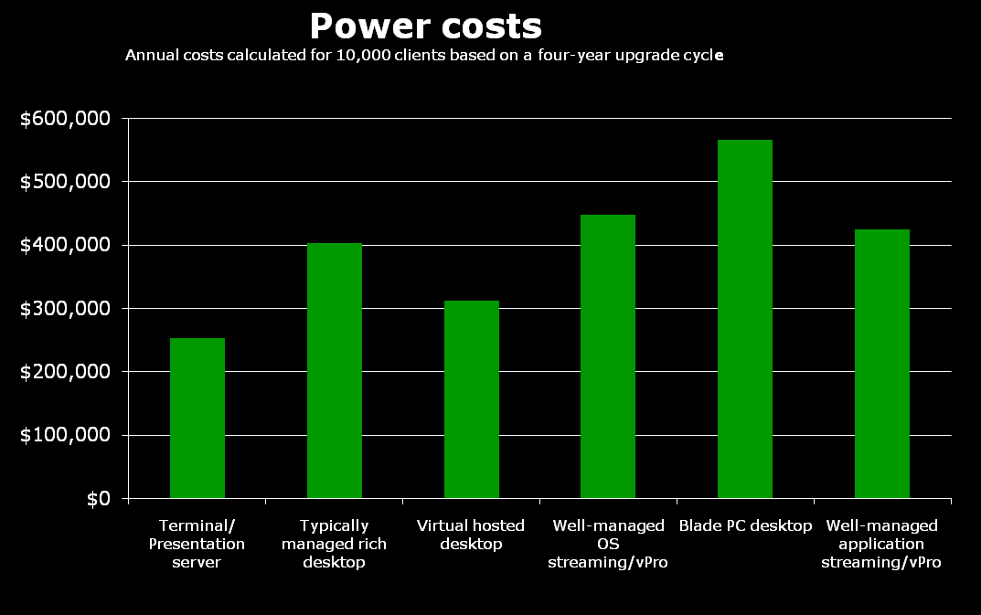
Power costs
The Terminal/ Presentation server model has the lowest power costs. Power costs for all models however, account for only a small fraction of the overall TCO.
The power costs cover the electricity needed to run the clients and servers and to keep them cool.
 | Terminal/ Presentation server | Typically managed rich desktop | Virtual hosted desktop | Well-managed OS streaming/vPro | Blade PC desktop | Well-managed application streaming/vPro
Total power consumed (kWh) | 3,172,880 | 5,036,046 | 3,901,992 | 5,593,602 | 7,066,780 | 5,307,676
Cost of power | $253,830 | $402,884 | $312,159 | $447,488 | $565,342 | $424,614
Note: We used lab test results to estimate the number of clients per access infrastructure server for all models except Virtual hosted desktop. For the Virtual hosted desktop model, we used a weighted average of the values from VMware Infrastructure 3 VDI Server Sizing and Scaling (http://www.vmware.com/pdf/vdi_sizing_vi3.pdf).

Slide 10
Manageability costs – Overview
MANAGEABILITY COSTS — Overview
The manageability costs are the ongoing costs to maintain and run the client infrastructure. We looked at the costs of the following:
  Maintaining an accurate inventory
  Patch management
  Support to resolve hardware and software problems
  Adding, moving, or deleting clients
  Security incidents, such as virus outbreaks
  Complying with laws and standards
  Managing the additional access and management servers required by each model

Slide 11
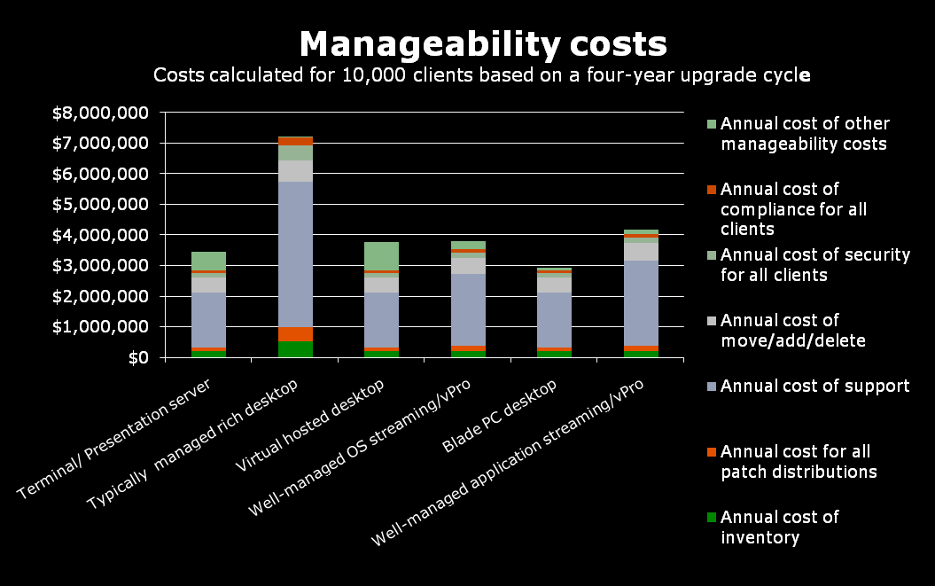
Manageability costs
Manageability costs are lowest with server-side and Blade PC desktop computing models.
The manageability costs are the ongoing costs to maintain and run the client infrastructure.
 | Terminal/ Presentation server | Typically managed rich desktop | Virtual hosted desktop | Well-managed OS streaming/vPro | Blade PC desktop | Well-managed application streaming/vPro
Annual cost of inventory | $198,924 | $528,432 | $198,924 | $198,924 | $198,924 | $198,924
Annual cost for all patch distributions | $127,190 | $466,396 | $127,190 | $163,856 | $127,190 | $163,856
Annual cost of support | $1,792,629 | $4,745,250 | $1,792,629 | $2,372,625 | $1,792,629 | $2,794,446
Annual cost of move/add/delete | $478,000 | $704,500 | $478,000 | $505,500 | $478,000 | $583,500
Annual cost of security for all clients | $151,800 | $474,500 | $151,800 | $177,200 | $151,800 | $177,200
Annual cost of compliance for all clients | $101,200 | $259,400 | $101,200 | $107,600 | $101,200 | $107,600
Annual cost of other manageability costs | $607,600 | $40,300 | $923,800 | $282,100 | $83,700 | $158,100
Total manageability cost | $3,457,343 | $7,218,778 | $3,773,543 | $3,807,805 | $2,933,443 | $4,183,626

Slide 12
Productivity/User experience costs - Overview
PRODUCTIVITY/USER EXPERIENCE COSTS — Overview
When multiple users simultaneously execute server-intensive tasks, some or all users may have to wait while the server processes all their work. To quantify the amount of time users lose to waiting during these instances, we followed this process:
Sum the total number of seconds it took each client to complete our three tests on the model in question when 10 users were running at once.
Subtract the sum of the times the rich clients required to execute the same tasks.
The result is the shared server penalty in productivity.
We estimated that the typical eight-hour workday contains at least the following four periods of peak usage when more than 10 users are simultaneously executing server-intensive tasks:
  at the beginning of the workday
  before lunch
  after lunch
  at the end of the workday
To calculate the total daily penalty per user per eight-hour workday, therefore, we multiplied the shared server penalty by four.
In the case of the Blade PC desktop, the script execution times were significantly slower than for rich clients with even one user. Therefore, we estimated that 10 times during the eight-hour workday, a typical user is attempting compute-intensive tasks. We then multiplied the shared server penalty for Blade PC desktop by 10 to get the total daily penalty for an eight-hour workday.

Slide 13
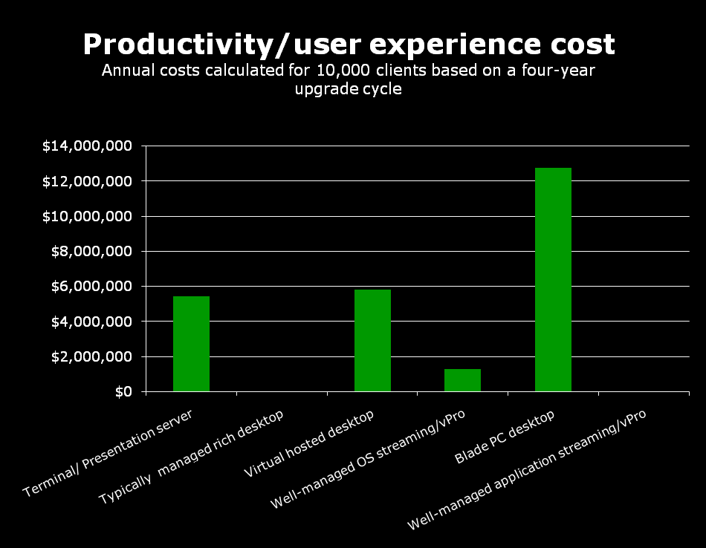
Productivity/User experience costs
The shared nature of server-side platforms and the slow nature of Blade PCs hinder user experience and productivity, particularly in the case of knowledge or power users.
Combining well-managed rich clients with application streaming and/or OS streaming can provide all the benefits of server-side computing models without significantly affecting productivity.
Because lost user productivity can easily be higher than any of the other costs in this analysis, enterprises need to consider those costs carefully.
 | Terminal/ Presentation server | Typically managed rich desktop | Virtual hosted desktop | Well-managed OS streaming/vPro | Blade PC desktop | Well-managed application streaming/vPro
Annual cost of lost productivity | $5,439,000 | $0 | $5,831,000 | $1,274,000 | $12,789,000 | $0
Total productive minutes lost per day on average | 3.25 | 0.00 | 3.50 | 0.75 | 7.70 | 0.00
Percent of productive time lost | 0.68% | 0.00% | 0.73% | 0.16% | 1.60% | 0.00%
  Note: We used lab test results to estimate the lost productivity for all models except Virtual hosted desktop. We estimated the lost productivity of the Virtual hosted desktop model to be between 2 and 5 seconds, so we used 3.5 seconds for our calculations.

Slide 14
Overall TCO – Overview
OVERALL TCO — Overview
The overall TCO is the combined initial and ongoing costs to maintain and run the client infrastructure. We looked at the following costs :
  Deployment
  Power
  Manageability
  Productivity/user experience
  Cost of data center space

Slide 15
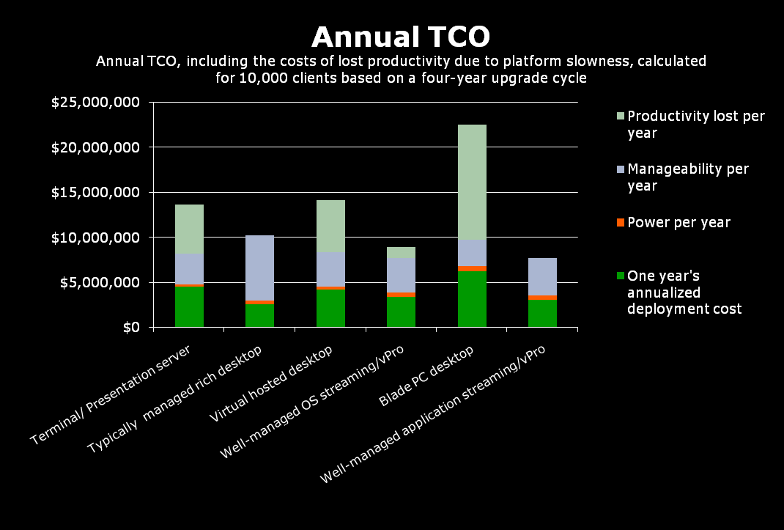

Total costs including lost productivity
TCO for server-side and Blade PC desktop computing models is higher than for client-side computing models primarily due to deployment costs and productivity losses.
TCO is the sum of acquisition costs and sustaining costs.
 | Terminal/ Presentation server | Typically managed rich desktop | Virtual hosted desktop | Well-managed OS streaming/vPro | Blade PC desktop | Well-managed application streaming/vPro
Annual costs per client | $1,370 | $1,025 | $1,419 | $898 | $2,254 | $774
Annual costs for all clients | $13,695,107 | $10,247,219 | $14,187,879 | $8,979,778 | $22,541,474 | $7,740,415
TCO per client for the upgrade cycle | $5,478 | $4,099 | $5,675 | $3,592 | $9,017 | $3,096
TCO for all clients for the upgrade cycle | $54,780,428 | $40,988,877 | $56,751,516 | $35,919,112 | $90,165,894 | $30,961,659
Note: We used lab test results to estimate the number of clients per access infrastructure server for all models except Virtual hosted desktop. For the Virtual hosted desktop model, we used a weighted average of the values from VMware Infrastructure 3 VDI Server Sizing and Scaling (http://www.vmware.com/pdf/vdi_sizing_vi3.pdf). We used lab test results to estimate the lost productivity for all models except Virtual hosted desktop. We estimated the lost productivity per day of the Virtual hosted desktop model to be between 2 and 5 minutes and used the average, 3.5 minutes, for our calculations.
Go to TCO, excluding productivity

Slide 16
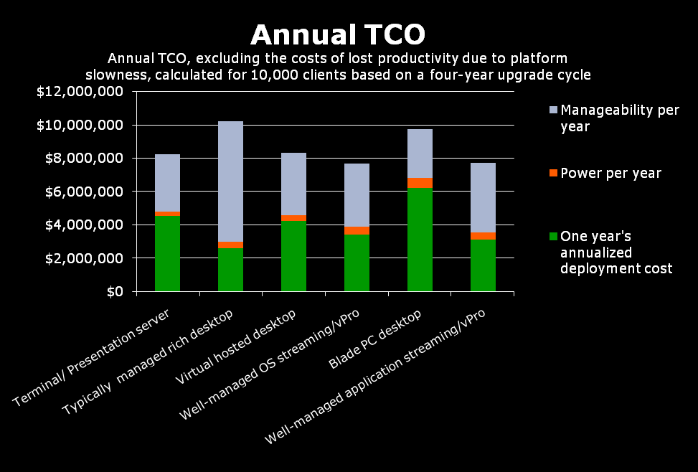

Total costs excluding lost productivity
Four of the six models have similar TCO if you exclude the costs of lost user productivity. The exceptions are the more costly Typically managed rich desktop and Blade PC desktop models.
TCO is the sum of acquisition costs and sustaining costs.
 | Terminal/ Presentation server | Typically managed rich desktop | Virtual hosted desktop | Well-managed OS streaming/vPro | Blade PC desktop | Well-managed application streaming/vPro
Annual costs per client | $826 | $1,025 | $836 | $771 | $975 | $774
Annual costs for all clients | $8,256,107 | $10,247,219 | $8,356,879 | $7,705,778 | $9,752,474 | $7,740,415
TCO per client for the upgrade cycle | $3,302 | $4,099 | $3,343 | $3,082 | $3,901 | $3,096
TCO for all clients for the upgrade cycle | $33,024,428 | $40,988,877 | $33,427,516 | $30,823,112 | $39,009,894 | $30,961,659
Note: We used lab test results to estimate the number of clients per access infrastructure server for all models except Virtual hosted desktop. For the Virtual hosted desktop model, we used a weighted average of the values from VMware Infrastructure 3 VDI Server Sizing and Scaling (http://www.vmware.com/pdf/vdi_sizing_vi3.pdf).
Go to TCO, including productivity

Slide 17
Security – Overview
SECURITY — Overview
For security, we examined the vulnerabilities of each model and the effort required to protect against those vulnerabilities. The vulnerabilities we looked at included the following:
  Virus contamination/malware
  Unauthorized access to information
  Theft of proprietary information
  Denial of service (DoS) attacks
  Hacking-related attacks
All other platforms we examined offer considerable security improvements over Typically managed rich desktops.

Slide 18
Security – Terminal/Presentation server
SECURITY — Terminal/Presentation server **** ( 4 stars)
More secure than the typically managed rich client, but not totally secure. Terminal/Presentation servers’ strengths are due to their lacking many of the desk-side features of rich clients.
Strengths
  Major strengths are related to two factors:
    Thin clients do not have user-accessible local storage.
    Thin clients reboot into a consistent state, as configured by IT:
      Users can not install nonstandard programs or fail to update patches.
      Viruses get cleared with a reboot.
  No local storage means data is not at risk if the client device is stolen.
  No built-in removable drives means users cannot copy data to a removable drive or copy unauthorized programs from the removable media to a server. (Note: Although many modern thin clients have USB ports, they typically allow only keyboards and mice. These ports can be a potential security problem if IT does not configure them properly.)
Weaknesses
  Though many consider them secure because they lack many features of a full PC, thin clients are not 100 percent secure, especially at the server side.
  Thin clients running a basic OS, such as Windows CE or a LINUX variant, can get memory-resident viruses. Viruses can run until IT reboots client.
  Viruses attacking middleware applications, such as email or Web browsers, are equally effective on all client types, including thin.
  Server-based technologies require more servers than rich clients, presenting more opportunities for server-based attacks.
  Server-based platforms are especially vulnerable to denial of service attacks. Network disruption or server loss stops all work and any uncommitted data is lost. Employees must wait for the server to return and redo lost work.

Slide 19
Security – Typically managed rich desktop
SECURITY — Typically managed rich desktop * (1 star)
More secure than unmanaged clients, but the most vulnerable of the client types and the most frequent targets of attack.
Strengths
Strengths depend upon IT’s intelligent application of common management practices:
  Requiring strong passwords, maintaining well-thought-out file access permissions, keeping anti-virus software and operating system patches up to date, securing server ports, and following other such practices greatly reduce the opportunities for attack.
  Users can work locally during a network disruption.
  Users can sometimes save work in progress locally if the network goes down.
Weaknesses
Inherent limitations make rich clients vulnerable to attack:
  The capabilities of the management tools limit management practices. Example: IT cannot push patches down to systems that are turned off or, in the case of laptops, not connected to the network.
  May be difficult for IT to verify that essential services, such as anti-virus software, are running.
  Rich clients are frequent targets of viruses, which can run undetected for days.
  Local storage on client puts sensitive data at risk and can also harbor viruses.
  Users’ considerable control over their systems creates potential security hazards:
    Users can install unauthorized software.
    Limits on patch deployment force many shops to count on voluntary compliance, risking a significant number of systems not being current.
    Users can expose sensitive data. Example: An employee copies a sensitive file to a thumb drive so he can work at home, thus creating a copy of sensitive data that is out of IT’s control.
    By default, users can change local security settings on the client.

Slide 20
Security – Virtual hosted desktop
SECURITY — Virtual hosted desktop **** (4 stars)
Enjoys many of the client-side security advantages of Terminal/Presentation server. Virtualization can improve security in certain circumstances, but maintaining a large number of OS images introduces risk.
Strengths
Virtual hosted desktop adds true virtualization to server-based computing:
  Each user session runs in a separate VM, making it much more difficult for one user session to affect another.
  Users can typically reconnect to an active session after a network disruption.
  No local storage means data is not at risk if the client device is stolen.
  No built-in removable drives means users cannot copy data to a removable drive or copy unauthorized programs from the removable media to a server. (Note: Although many modern thin clients have USB ports, they typically allow only keyboards and mice. These ports can be a potential security problem if IT does not configure them properly.)
Weaknesses
Inherits weakness of Terminal/Presentation server. Connection broker and large number of images can be targeted for attack.
  The connection broker itself can be a potential target.
  Individual OS images can get infected and copied to server.
  A VHD implementation does not change the fact that thin clients running a basic OS, such as Windows CE or a Linux variant, can get memory-resident viruses. Viruses can run until IT reboots client.
  Viruses attacking middleware applications, such as email or Web browsers, are equally effective on all client types.
  VHD implementations require more servers than rich clients, presenting more opportunities for server-based attacks.
  VHD implementations are especially vulnerable to denial of service attacks. Network disruption or server loss stops all work and any uncommitted data is lost. Employees must wait for the server to return and redo lost work.

Slide 21
Security – Well-managed OS streaming desktop/vPro
SECURITY — Well-managed OS streaming desktop/vPro ***** (5 stars)
OS streaming adds to the OS and data security of the Typically managed rich desktop model. A well-managed infrastructure cuts costs for deployment and manageability. Intel vPro technology provides security-enabling features.
Note: For this analysis, we assume that the OS streaming vendor is Ardence and each user has a static server-based disk image.
Strengths
  Tight control of OS image with OS streaming adds additional security to the Typically managed rich desktop model.
  Intel vPro technology provides a collection of powerful security-enabling features that help administrators defend against security threats. Third party management tools can use these technologies to:
    Filter out threats from network traffic
    Create virtual appliances dedicated to a particular function, such as security
    Enable a PC to send instant notification if agents, such as anti-virus, go missing.
    Detect virus activity and isolate compromised PCs faster, in some cases stopping a virus before it even reaches the OS.
    Keeps configuration information, including encryption keys, safe from tampering.
  IT can easily control and update OS version and patches.
  Users cannot corrupt system files.
  No local storage means data is not at risk if the client device is stolen.
  Strong passwords, well-thought-out file access permissions, up-to-date anti-virus software and operating system patches, secure server ports, and other such sound management practices greatly reduce opportunities for attack.
Weaknesses.
  To benefit from Intel vPro technology, IT must use third-party software, as well as define and adhere to sound management practices. Without proper management, security nearly mirrors that of Typically managed rich desktop computing model.

Slide 22
Security – Blade PC desktop
SECURITY — Blade PC desktop *** (3 stars)
Has many of the client-side security advantages of Terminal/Presentation server. Running on dedicated physical systems can improve security in certain circumstances, but maintaining a large number of OS images introduces risk.
Note: We assume a dynamic blade implementation, where each user can attach to any blade.
Strengths
  Client sessions are isolated on blade PCs.
  Each user session runs in a separate physical system, making it nearly impossible for one user session to affect another.
  Users can typically reconnect to an active session after a network disruption.
  Although the blade PC has local storage, the blade is safe in a data center.
  Because users have no physical access to the blade PC, they cannot use its ports to copy data to a removable drive or copy unauthorized programs from the removable media to a server. (Note: Users’ thin clients can have USB ports, which users can use to copy data from the network if IT does not configure them properly.)
Weaknesses
  Blade PC desktop inherits weakness of Terminal/Presentation server as well as some of the problems of rich clients and VHD.
  Session Allocation Manager (SAM) can be a target.
  Individual OS images on blades can get infected.
  Thin clients running a basic OS, such as Windows CE or Linux, can get memory-resident viruses. Viruses can run until IT reboots client.
  Viruses attacking middleware applications, such as email or Web browsers, are equally effective on all client types.
  Blade PC desktop implementations require more devices than rich clients, presenting more opportunities for attacks.
  Blade PC desktop implementations are especially vulnerable to denial of service attacks. Network disruption stops all work and loses any uncommitted data. Employees must wait for the network to return and redo any lost work.

Slide 23
Security – Well-managed application streaming desktop/vPro
SECURITY — Well-managed application streaming desktop/vPro **** (4 stars)
Adds to the application security of the Typically managed rich desktop model. A well-managed infrastructure cuts costs for deployment and manageability. Intel vPro technology provides a collection of security-enabling features
Strengths
  Intel vPro technology provides a collection of powerful security-enabling features that help administrators defend against security threats. Third party management tools can use these technologies to:
    Filter out threats from network traffic
    Create virtual appliances dedicated to a particular function, such as security
    Enable a PC to send instant notification if agents, such as anti-virus, go missing.
    Apply patches or repair the system image, even if the system is powered off.
    Detect virus activity and isolate compromised PCs faster, in some cases stopping a virus before it even reaches the OS.
    Keeps configuration information, including encryption keys, safe from tampering.
  Strong passwords, well-thought-out file access permissions, up-to-date anti-virus software and operating system patches, secure server ports, and other such sound management practices greatly reduce opportunities for attack.
  With application streaming, IT is able to keep application versions and patches current with relative ease. And protect application files from corruption .
  Users cannot corrupt application files.
  IT can configure clients so that users can continue working locally if the network goes down.
Weaknesses
  To benefit from Intel vPro technology, IT must use third-party software, as well as define and adhere to sound management practices. Without proper management, security nearly mirrors that of Typically managed rich desktop computing model.
  Local storage on client puts sensitive data at risk and can also harbor viruses.

Slide 24
Future proofing – Overview
FUTURE PROOFING / RICH APPLICATION SUPPORT — Overview
Future proofing looks at the ability of each model to deal with the demands of emerging applications, tools, content, and needs. The factors we looked at included the following:
  The features of the client, such as type and availability of ports
  The demands of rich applications
  The demands of rich collaboration tools such as Live Meeting
  The demands of rich Internet content such as Macromedia Flash animation
  The life cycle of the clients
  The demands of Microsoft Windows Vista (e.g., the Aero interface)
  The expectations of current applications
  The upgrade path for the client type
Client-side computing models based on rich desktops and notebooks offer significant future-proofing benefits over server-side and Blade PC desktop models. Notably, server-side models offer limited multimedia and rich collaboration support as well as limited Flash-based Internet usage.

Slide 25
Future proofing – Terminal/Presentation server
FUTURE PROOFING — Terminal/Presentation server ** (2 stars)
Terminal/Presentation server is the least future-proof model, much less versatile than rich clients.
Strengths
  Depending on the application, you can increase application performance at the server by enhancing server hardware or adding servers.
Weaknesses
  Doing more on server-based platforms means either doing more on the server or replacing the clients. Thin clients by nature are rarely upgradeable.
  The trend for applications is to support heavier data formats, such as XML, that can place significant performance demands on the underlying processor. New applications and application features that involve media content such as pictures, sound, and video accelerate this trend.
  Rich media based, VOIP, and compute-intensive tasks are not well suited to server-based platforms.
  Thin clients may exclude features, such as new I/O technology ports, that future technologies will require.
  More graphically intense interfaces in products such as Microsoft Windows Vista Aero are nearly unusable on server-based platforms.
  Applications written with rich clients in mind will not always run on server-based platforms, requiring porting or replacement.

Slide 26
Future proofing – Typically managed rich desktop
FUTURE PROOFING — Typically managed rich desktop **** (4 stars)
One of the biggest advantages of rich clients over the years has been their versatility and their ability to run new, never-before-thought-of applications and hardware.
Strengths
  Doing more on a rich client typically means adding only an I/O card, additional memory, or a peripheral. Rich clients are by nature extremely upgradeable.
  The trend for applications is to support heavier data formats, such as XML, that can place significant performance demands on the underlying processor. New applications and application features that involve media content such as pictures, sound, and video accelerate this trend.
  Rich clients include features, such as new I/O technology ports, that future technologies will require.
  Rich clients easily support more graphically intense interfaces in products such as Microsoft Windows Vista Aero.
  Most applications are written with rich clients in mind.
Weaknesses
  Desktops are highly dependent on desk-side visits for upgrades.
  Upgrade path for traditional rich clients can be complex.

Slide 27
Future proofing – Virtual hosted desktop
FUTURE PROOFING — Virtual hosted desktop *** (3 stars)
Virtual hosted desktop does a good job of virtualizing the environment and abstracting hardware differences. However, the use of a thin client for the VHD access is a poor choice for future proofing. Much less versatile than rich clients.
Strengths
  Depending on the application, you can increase application performance at the server by enhancing server hardware or adding servers.
  VM memory isolation means application porting or replacement is almost never necessary.
Weaknesses
  Doing more on server-based platforms means either doing more on the server or replacing the clients. Thin clients by nature are rarely upgradeable.
  The trend for applications is to support heavier data formats, such as XML, that can place significant performance demands on the underlying processor. New applications and application features that involve media content such as pictures, sound, and video accelerate this trend.
  Rich media based, VOIP, and compute-intensive tasks are not well suited to server-based platforms .
  Thin clients may exclude features, such as new I/O technology ports, that future technologies will require.
  More graphically intense interfaces in products such as Microsoft Windows Vista Aero are nearly unusable on server-based platforms.

Slide 28
Future proofing – Well-managed OS streaming desktop/vPro
FUTURE PROOFING — Well-managed OS streaming desktop/vPro **** (4 stars)
One of the biggest advantages of rich clients has been their versatility and their ability to run new, never-before-thought-of applications and hardware. OS streaming extends this advantage by allowing easy upgrades for common platforms. Intel vPro technology, in conjunction with third-party products, address many of the future-proofing problems of the other platforms.
Strengths
  Upgrading OS software to support new applications can be easier with OS streaming in some instances.
  Doing more on a rich client typically means adding only an I/O card, additional memory, or a peripheral. Rich clients are by nature extremely upgradeable.
  The trend for applications is to support heavier data formats, such as XML, that can place significant performance demands on the underlying processor. New applications and application features that involve media content such as pictures, sound, and video accelerate this trend.
  Rich clients include features, such as new I/O technology ports, that future technologies will require.
  Rich clients easily support more graphically intense interfaces in products such as Microsoft Windows Vista Aero.
  Most applications are written with rich clients in mind.
  Intel Virtualization Technology can let IT create “virtual appliances,” self-contained operating environments dedicated to a particular function, such as security.
  Intel AMT, Remote Power-on, and SIPP let IT push updates simply and remotely.
  SIPP enables future technologies to share the same image.
  Intel vPro technology support for cutting edge technologies and standards offers the best chance of supporting future products.
Weaknesses
  Management is necessary to get full benefit of Intel vPro technology. Without proper management tools, future proofing nearly mirrors that of typically managed rich clients.
  Upgrade path for traditional rich clients can be complex; however, certain Intel vPro capabilities like AMT and SIPP can mitigate this complexity.
  OS streaming can limit the performance of disk-intensive applications.

Slide 29
Future proofing – Blade PC desktop
FUTURE PROOFING — Blade PC desktop * (1 star)
The least future proof of the models, locking companies into technologies at both the client and server level. Much less versatile than rich clients.
Strengths
  Blades have some limited upgrade capability, letting you increase application performance at the blade.
  Rich client applications run without porting on blade PCs.
Weaknesses
  Blade PCs have many of the weakness of server-based platforms.
  Doing more on Blade PCs means either replacing the clients or upgrading or replacing the blades.
  Switching between blade PCs vendors may be difficult.
  Blade PCs tend to be proprietary.
  Thin clients used to access the blade PCs are by nature rarely upgradeable.
  The trend for applications is to support heavier data formats, such as XML, that can place significant performance demands on the underlying processor. New applications and application features that involve media content such as pictures, sound, and video accelerate this trend.
  Thin clients may exclude features, such as new I/O technology ports, that future technologies will require.
  More graphically intense interfaces in products such as Microsoft Windows Vista Aero are nearly unusable on blade PCs without specialized solutions.
  Blade PC vendors offer a very limited number of blades types, and have typically been slow to respond to new technologies.

Slide 30
Future proofing – Well-managed application streaming desktop/vPro
FUTURE PROOFING — Well-managed application streaming desktop/vPro ***** (5 stars)
One of the biggest advantages of rich clients has been their versatility and their ability to run new, never-before-thought-of applications and hardware. Intel vPro technology, in conjunction with third-party products, addresses many of the future-proofing problems of the other models.
Strengths
  Application streaming significantly cuts the work of distributing new applications and application features to rich clients.
  Doing more on a rich client typically means adding only an I/O card, additional memory, or a peripheral. Rich clients are by nature extremely upgradeable.
  The trend for applications is to support heavier data formats, such as XML, that can place significant performance demands on the underlying processor. New applications and application features that involve media content such as pictures, sound, and video accelerate this trend.
  Rich clients include features, such as new I/O technology ports, that future technologies will require.
  Rich clients easily support more graphically intense interfaces in products such as Microsoft Windows Vista Aero.
  Most applications are written with rich clients in mind.
  Intel Virtualization Technology lets IT create “virtual appliances,” self-contained operating environments dedicated to a particular function, such as security.
  Intel AMT, Remote Power-on, and SIPP let IT push updates simply and remotely.
  SIPP enables future technologies to share the same image.
  Intel vPro technology support for cutting edge technologies and standards offers the best chance of supporting future products.
Weaknesses
  Management is necessary to get full benefits of Intel vPro technology. Without proper management tools, future proofing nearly mirrors that of typically managed rich clients.
  Upgrade path for traditional rich clients can be complex; however certain Intel vPro capabilities like AMT and SIPP can mitigate this complexity.

Slide 31
Desktop environmental – Overview
DESK-SIDE ENVIRONMENTAL — Overview
Desk-side environmental refers to those factors that affect users’ physical comfort, and thus their productivity. The factors we looked at included the following:
  Noise
  Heat
  Footprint
  Stability
Smaller and usually cooler and quieter than rich clients, thin clients used in server-side and Blade PC desktop models have less of an impact on the desk-side environment.

Slide 32
Desktop environmental – Terminal/Presentation server
DESK-SIDE ENVIRONMENTAL — Terminal/Presentation server **** (4 stars)
Smaller and usually cooler and quieter than rich clients, Terminal/Presentation server’s thin clients have a much smaller impact on the desk-side environment.
Strengths
  Thin clients generally have smaller footprints than rich clients.
  Thin clients, most of which produce no fan noise, are very quiet.
  In general, thin clients produce less heat than rich clients.
Weaknesses
  Some thin clients, including the Wyse Winterm V50 we used in our testing, generate noticeable heat.
  The cables attached to the thin client can be heavier than the thin client itself, making the thin client relatively prone to falling over.

Slide 33
Desktop environmental – Typically managed rich desktop
DESK-SIDE ENVIRONMENTAL — Typically managed rich desktop ** (2 stars)
Strengths
  Good case design on many rich clients greatly reduces noise.
  Power-saving technologies, such as EIST (Enhanced Intel SpeedStep technology), reduce heat.
  Rich clients are stable and difficult to tip over.
Weaknesses
  Rich clients generally have a bigger footprint than thin clients, taking up valuable desk (or floor) space.
  Even with good case design, rich clients usually produce at least some noticeable noise.
  The heat the case and processor fans pull off the typical rich client can raise the office temperature.

Slide 34
Desktop environmental – Virtual hosted desktop
DESK-SIDE ENVIRONMENTAL — Virtual hosted desktop **** (4 stars)
The desk-side environment of Virtual hosted desktop is identical to that of other server-based platforms. Smaller and usually cooler and quieter than rich clients, thin clients have a much smaller impact on the desk-side environment.
Strengths
  Thin clients generally have smaller footprints than rich clients.
  Thin clients, most of which produce no fan noise, are very quiet.
  In general, thin clients produce less heat than rich clients.
Weaknesses
  Some thin clients, including the Wyse Winterm V50 we used in our testing, generate noticeable heat.
  The cables attached to the thin client can be heavier than the thin client itself, making the thin client relatively prone to falling over.

Slide 35
Desktop environmental – Well-managed OS streaming desktop/vPro
DESK-SIDE ENVIRONMENTAL — Well-managed OS streaming desktop/vPro ** (2 stars)
The desk-side environment is identical to that of other client-side platforms.
Strengths
  Good case design on many rich clients greatly reduces noise.
  Power-saving technologies, such as EIST (Enhanced Intel SpeedStep technology), reduce heat.
  Rich clients are stable and difficult to tip over.
Weaknesses
  Rich clients generally have a bigger footprint than thin clients, taking up valuable desk (or floor) space.
  Even with good case design, rich clients usually produce at least some noticeable noise.
  The heat the case and processor fans pull off the typical rich client can raise the office temperature.

Slide 36
Desktop environmental – Blade PC desktop
DESK-SIDE ENVIRONMENTAL — Blade PC desktop **** (4 stars)
The desk-side environment of Blade PC desktop is identical to that of other server-based platforms. Smaller and usually cooler and quieter than rich clients, thin clients have a much smaller impact on the desk-side environment.
Strengths
  Thin clients generally have smaller footprints than rich clients.
  Thin clients, most of which produce no fan noise, are very quiet.
  In general, thin clients produce less heat than rich clients.
Weaknesses
  Some thin clients, including the Wyse Winterm V50 we used in our testing, generate noticeable heat.
  The cables attached to the thin client can be heavier than the thin client itself, making the thin client relatively prone to falling over.

Slide 37
Desktop environmental – Well-managed application streaming desktop/vPro
DESK-SIDE ENVIRONMENTAL — Well-managed application streaming desktop/vPro ** (2 stars)
The desk-side environment is identical to that of other client-based platforms.
Strengths
  Good case design on many rich clients greatly reduces noise.
  Power-saving technologies, such as EIST (Enhanced Intel SpeedStep technology), reduce heat.
  Rich clients are stable and difficult to tip over.
Weaknesses
  Rich clients generally have a bigger footprint than thin clients, taking up valuable desk (or floor) space.
  Even with good case design, rich clients usually produce at least some noticeable noise.
  The heat the case and processor fans pull off the typical rich client can raise the office temperature.

Slide 38
Compliance – Overview
COMPLIANCE — Overview
Compliance deals with the relative ease or difficulty of complying with license restrictions, laws such as the Sarbanes-Oxley Act (Sarbox), and standards such as the Payment Card Industry Data Security Standard (PCI DSS). Factors we looked at include the following:
  Availability of data for audit or examination
  Susceptibility to sensitive data being modified
  Safety of data from unauthorized access, including erasure of prohibited data (e.g., merchants who do not erase customer credit card information after a transaction, as required by PCI DSS)
All other computing models we examined offer significant compliance benefits over Typically managed rich desktops.

Slide 39
Compliance – Terminal/Presentation server
COMPLIANCE — Terminal/Presentation server ***** (5 stars)
By forcing the entire user environment to the server, the Terminal/Presentation server model simplifies and improves compliance.
Strengths
  Less IT effort required to monitor data and application compliance and back up data when data and applications are server based than if they are on desktops.
  Unauthorized access requires gaining access to the server—with a hack, through a compromised user account, etc. This is much more difficult than getting access to a typically managed local system.
  With no local disk, users are less likely to create copies of prohibited data.
Weaknesses
  Poorly configured thin clients can pose risks. For example, active USB ports can let users copy data.
  Web access and email pose compliance risks to all client types.

Slide 40
Compliance – Typically managed rich desktop
COMPLIANCE — Typically managed rich desktop * (1 star)
Careful management and the right tools can keep the Typically managed rich desktop computing model clients compliant. However, such clients lack the structural advantages of thin clients and the enhanced features of Intel vPro technology, which aid compliance on those platforms.
Strengths
  Well-thought-out policies and use of management tools greatly enhance compliance compared to unmanaged rich clients.
  IT can improve compliance by adding the additional management controls of well-managed enterprises while maintaining the same client desktops.
Weaknesses
  Users can easily delete local data, which IT may never have backed up.
  Users can easily alter local data.
  Data can be copied or stolen because it resides on local devices that are prone to intrusion and physical theft.
  Users might not follow required data retention or deletion requirements.
  Users can install unauthorized copies of applications, violating license agreements.
  Web access and email pose compliance risks to all client types.

Slide 41
Compliance – Virtual hosted desktop
COMPLIANCE — Virtual hosted desktop **** (4 stars)
Because the Virtual hosted desktop model uses thin clients at the desk, it has many of the Terminal/Presentation server strengths. However, the individual workspaces can potentially hide prohibited data.
Strengths
  IT requires less effort and cost to monitor data and application compliance and back up data when data and applications are server based than if they are on desktops.
  Unauthorized access requires gaining access to the server—with a hack, through a compromised user account, etc. This is much more difficult than getting access to a typically managed local system.
  With no local disk, users are less likely to create copies of prohibited data.
Weaknesses
  Virtual hosted desktops store a separate image for each user, making possible multiple copies of prohibited data.
  Poorly configured thin clients can pose risks. For example, active USB ports can let users copy data.
  Web access and email pose compliance risks to all client types.

Slide 42
Compliance – Well-managed OS streaming desktop/vPro
COMPLIANCE — Well-managed OS streaming desktop/vPro **** (4 stars)
OS streaming uses rich clients enabled with Intel vPro technology, generally with no local storage, at the desk. With no local storage, OS streaming has many of the advantages of thin clients in addition to advantages of well-managed desktops.
Note: Although it is possible to have local disks in an OS streaming environment, we only consider the more common case where there is no local storage.
Strengths
  IT requires less IT effort and cost to monitor data and application compliance and back up data when data and applications are server based than if they are on desktops.
  Unauthorized access requires gaining access to the server—with a hack, through a compromised user account, etc. This is much more difficult than getting access to a typically managed local system.
  With no local disk, users are less likely to create copies of prohibited data.
Weaknesses
  Users might be able to install unauthorized applications, violating license agreements.
  Poorly configured clients can pose risks. For example, active USB ports could let users copy data.
  Web access and email pose compliance risks to all client types.

Slide 43
Compliance – Blade PC desktop
COMPLIANCE — Blade PC desktop **** (4 stars)
Because the Blade PC desktop model uses thin clients at the desk, it has many of the strengths of the Terminal/Presentation server platform. However, the individual workspaces have the potential to hide prohibited data.
Strengths
  Blade PCs are at the data center and under IT control, facilitating data backup and data and application compliance auditing and enforcement.
  With no local disk, users are less likely to create copies of prohibited data.
Weaknesses
  Individual workspaces have the potential to hide prohibited data.
  Poorly configured thin clients can pose risks. For example, active USB ports can let users copy data.
  Web access and email pose compliance risks to all client types.

Slide 44
Compliance – Well-managed application streaming desktop/vPro
COMPLIANCE — Well-managed application streaming desktop/vPro
**** (4 stars)
Because Well-managed application streaming desktop/vPro uses rich clients at the desk, it can be vulnerable to many of the problems of typically managed rich clients. However, IT’s greater control over streamed applications improves those applications’ compliance.
Strengths
  Streamed applications comply with license agreements.
  Well-thought-out policies and use of management tools greatly enhance compliance compared to unmanaged rich clients.
  In conjunction with third-party management tools, Intel vPro technology and Intel AMT are capable of the following:
    Enabling capabilities such as remotely backing up powered-off systems, reducing the likelihood of data loss
    Improving data security
    Improving enforcement of software license agreements, such as using SIPP to guarantee client images are conformant
Weaknesses
  Local data might never reach the server and therefore, not be backed up.
  Users can easily change local data.
  Users might not delete prohibited data as required.
  Web access and email pose compliance risks to all client types.

Slide 45
Performance – Overview
PERFORMANCE — Overview To compare model performance, we ran three different applications scenarios on each type of client:
Acrobat Compress. This single-task scenario tested how quickly the test system was able to open Adobe Acrobat and compress a 4.01MB PDF file (located on the file server) from within the Acrobat application. Excel Subtotals. This single-task scenario tested how quickly Microsoft Excel could perform the subtotal function on a 1.79MB Excel spreadsheet (located on the file server). Explorer Compress and PPT Change View. This multitasking scenario tested how long it took to compress a 256MB folder (located on the file server for the thin clients, local for the rich clients) while changing views within a 30.4MB Microsoft PowerPoint presentation (located on the file server).
Each of our test networks included a file server and 10 client systems. We used a pair of identical file servers to allow us to test two networks at a time. We used a 100Mbps network infrastructure for the clients and a 1Gbps network infrastructure for the servers to reflect typical scenarios in enterprises today. We also set up access infrastructure servers for the models that required them. We ran the three test scripts on each test network with four client configurations: a single client running the script and then 2, 5, and 10 clients simultaneously running the script. Our performance comparison is the sum of script execution times for the three test scenarios in seconds. Lower results are better. We did not test the Virtual hosted desktop model.

Slide 46
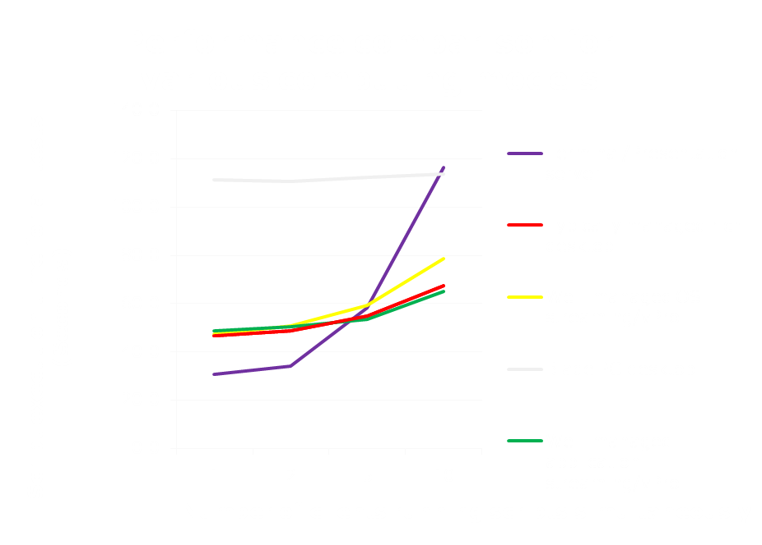
Performance – Summary
PERFORMANCE — Summary
Client-side computing models showed impressive performance gains over server-side and Blade PC desktop models in our tests. Productivity loss can be significant for knowledge or power users on server-side and Blade PC desktop models.

Slide 47
Mobility – Overview
MOBILITY — Overview
Mobility looks at the suitability of replacing desktop clients in each model with notebooks. The factors we looked at included the following:
  Ability to work off line
  Compactness
  Complexity
  Licensing impact, as in application streaming
Note: We considered thin client notebooks for server-based computing models and rich client notebooks for the rich client models.
True mobility support is available only with the application streaming computing model.

Slide 48
Mobility – Terminal/Presentation server
MOBILITY — Terminal/Presentation server * (1 star)
Because Terminal/Presentation servers require a network connection to a server for the thin clients to operate, this model offers poor mobility.
Note: Although it is possible to use rich notebooks in a Terminal/Presentation server environment, we only considered the case of thin notebooks.
Strengths
  Thin client notebooks’ small processing and memory requirements can make for compact designs.
  Because they have no local data, thin client notebooks rarely cause compliance and data loss problems when stolen or lost.
  Manageability is the same for thin client desktops and notebooks.
Weaknesses
  Because they require a network connection, thin client notebooks do not work on airplanes and other locations where network connections are unavailable or limited.

Slide 49
Mobility – Typically managed rich desktop
MOBILITY — Typically managed rich desktop **** (4 stars)
Rich desktops (notebook PCs) are available in a wide variety of mobile form factors. Their ability to run applications without a network connection means users can be productive anywhere.
Strengths
  Rich client notebooks are available with similar functionality to rich client desktops. Users give up little, if any, functionality when they go mobile.
  Because users of rich client notebooks can do much of their work offline, they can be functional in locations where network connections are unavailable or limited.
  Users can choose among notebooks in a variety of sizes and weights with a range of processing and graphics capabilities.
Weaknesses
  Notebooks are prone to theft or loss. Replacement costs can burden the IT budget. More costly, however, is the cost of lost data and the related compliance problems.
  Manageability can be a problem with notebooks. For some notebooks, remote manageability software is able to access the notebook only when it is powered on and connected to the network, leaving the notebook prone to security and compliance problems.

Slide 50
Mobility – Virtual hosted desktop
MOBILITY — Virtual hosted desktop * (1 star)
Because the Virtual hosted desktop computing model uses thin clients and requires a network connection to a server to operate, this model offers poor mobility.
Note: Although it is possible to use rich notebooks in a Virtual hosted desktop environment, we only consider the case of thin notebooks.
Strengths
  Thin client notebooks’ small processing and memory requirements can make for compact designs.
  Because they have no local data, thin notebooks rarely cause compliance and data loss problems when stolen or lost.
  Manageability is the same for thin client desktops and notebooks.
Weaknesses
  Because they require a network connection, thin client notebooks do not work on airplanes and other locations where network connections are unavailable or limited.

Slide 51
Mobility – Well-managed OS streaming desktop/vPro
MOBILITY — Well-managed OS streaming desktop/vPro * (1 star)
One of the strengths of the Ardence OS streaming solution is its ability to run with unstable network connections. It does not however run offline. As a result, OS streaming shares the mobility limitations of thin clients notebooks. In the face of these limitations and wanting a truly mobile solution for their users, enterprises typically set up two profiles on notebooks: an OS streamed profile for in the office and a local disk profile for out of the office. With this implementation, OS streaming is not a mobility solution because the notebook devices are operating as rich clients when out of the office, not OS streaming clients .
We could have given this model a rating of Not applicable (NA) on the mobility category because OS streaming rarely goes mobile. However, because the rich client notebooks that support OS streaming can go mobile when running the second profile and because mobile OS streaming is technically even if not practically feasible, we gave the solution a single star.

Slide 52
Mobility – Blade PC desktop
MOBILITY — Blade PC desktop * (1 star)
Because the Blade PC desktop model uses thin clients and requires a network connection to the blade PC to operate, it offers poor mobility.
Note: Although it is possible to use rich notebooks in a Blade PC desktop environment, we only consider the case of thin notebooks.
Strengths
  Thin client notebooks’ small processing and memory requirements can make for compact designs.
  Because they have no local data, thin client notebooks rarely cause compliance and data loss problems when stolen or lost.
  Manageability is the same for thin client desktops and notebooks.
Weaknesses
  Because they require a network connection, thin client notebooks do not work on airplanes and other locations where network connections are unavailable or limited.

Slide 53
Mobility – Well-managed application streaming desktop/vPro
MOBILITY — Well-managed application streaming desktop/vPro
***** (5 stars)
Rich client notebooks running application streaming can work offline, but do require some effort and cost to set them up to operate that way.
Strengths
  Notebooks enabled with Intel Centrino Pro technology are available with similar functionality to desktops enabled with Intel vPro technology. Users give up little, if any, functionality to go mobile.
  Because users of rich notebooks can do much of their work offline, they can be functional in locations where network connections are unavailable or limited.
  Users can choose from notebooks in a variety of sizes and weights with a range of processing and graphics capabilities.
  Notebooks enabled with Intel Centrino Pro technology are more manageable than traditional rich notebooks with benefits of greater compliance and security.
  Application streaming allows the user to have full application functionality while on the road.
  Application streaming automatically synchronizes the application image when the user is connected to the corporate network.
Weaknesses
  Notebooks are prone to theft or loss. Replacement costs can burden the IT budget.
  Application streaming can operate without a network connection. However, to do so can increase the number of software licenses required.

Slide 54
Access infrastructure – Overview
ACCESS INFRASTRUCTURE — Overview
The Access infrastructure category refers to the number of clients each access infrastructure server¹ can support. In this context, an access infrastructure server is one that does the work that would be done on a rich client in a traditional environment. The Typically managed rich desktop and Blade PC desktop models do not include these servers.
 | Terminal/ Presentation server | Typically managed rich desktop | Virtual hosted desktop | Well-managed OS streaming/ vPro | Blade PC desktop | Well-managed application streaming/vPro
Number of clients per access infrastructure server² | 57 | N/A | 36³ | 153 | N/A | 399
¹Server specifications: Two 3GHz Intel Xeon 5160 dual-core processors Memory: 16GB DDR2 SRAM
²We used lab test results to estimate the number of clients per access infrastructure server for all models except Virtual hosted desktop.
³For the Virtual hosted desktop model, we used a weighted average of the values from VMware Infrastructure 3 VDI Server Sizing and Scaling (http://www.vmware.com/pdf/vdi_sizing_vi3.pdf).

Slide 55
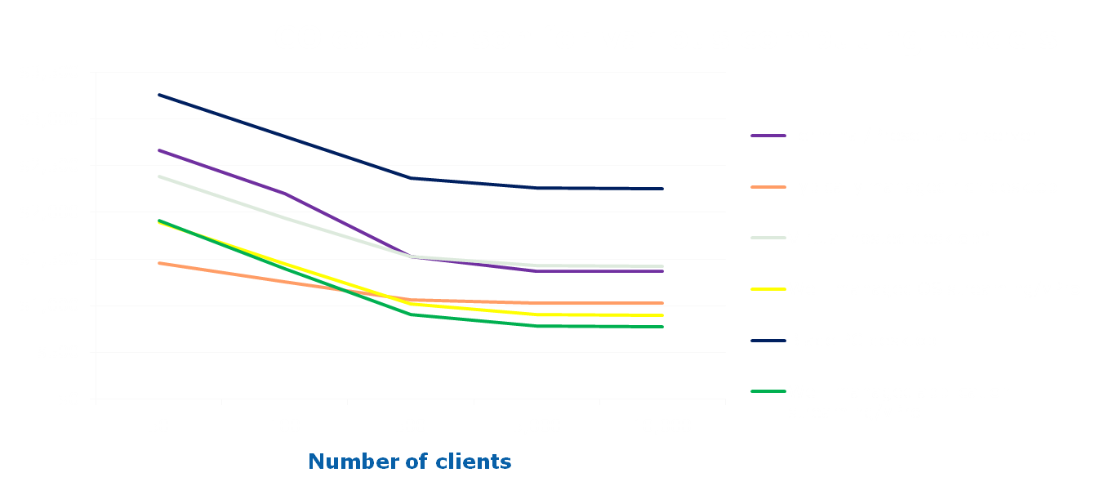
TCO scaling – Overview
TCO SCALING — Overview
TCO scaling refers to the effect of increased client count on costs. Costs can change at a different rate than the number of clients. The graph depicts actual calculated data points for 50, 100, 500, 5,000, and 10,000 clients and includes the impact of lost productivity.
Note: We used lab test results to estimate the number of clients per access infrastructure server for all models except Virtual hosted desktop. For the Virtual hosted desktop model, we used a weighted average of the values from VMware Infrastructure 3 VDI Server Sizing and Scaling (http://www.vmware.com/pdf/vdi_sizing_vi3.pdf). We used lab test results to estimate the lost productivity for all models except Virtual hosted desktop. We estimated the lost productivity of the Virtual hosted desktop model to be between 2 and 5 seconds, so we used 3.5 seconds for our calculations.

Slide 56
Microsoft Windows Vista migration
Microsoft Windows Vista migration
In this analysis, we considered costs based on Windows XP Professional version 2002 with Service Pack 2 for all models except Terminal/presentation server. A Microsoft Windows Vista migration would have different cost considerations for the various computing models in this analysis. Most of these considerations are not relevant to the Terminal/presentation server computing model because this model does not host applications on the client operating system.
Microsoft Windows Vista license costs
  Microsoft Windows Vista licenses would add costs.
Operating system deployment costs
  Deployment costs would be high for the typically managed rich platform due to its high touch requirements for all manageability tasks.
  The centralized nature of the Virtual hosted desktop, Well-managed OS streaming/vPro, and Blade PC desktop computing models makes Vista deployments less expensive.
  Vista deployment for the Well-managed application streaming/vPro computing model using enhanced vPro management technologies is less expensive than for the Typically managed rich platform.
Costs of incompatible applications
Commercial off-the-shelf (COTS), custom, or homegrown applications may be incompatible. IT would need to test these applications and replace or port them as necessary. For enterprises that can’t wait to resolve incompatibilities before deployment, the computing models offer different solutions or workarounds for deploying incompatible applications. Each of these solutions can add significant costs to the deployment.
  In the Well-managed OS streaming/vPro and Virtual hosted desktop computing models, IT can deploy Vista-incompatible applications by providing multiple OS streamed images or virtual desktops that pair Vista-compatible applications with Vista OS and non-Vista-compatible applications with the original OS.
  In the Typically managed rich platform, the Well-managed application streaming/vPro computing models, and the Blade PC desktop model, Virtual PC 2007 or dual-boot installation can support Vista-incompatible applications. The client could also connect to legacy applications via RDP or ICA running on Presentation servers, Blade PCs, or VM servers.
  In the Blade PC desktop computing model, IT can resolve application incompatibilities by providing separate blade images for Vista-compatible and non-Vista-compatible applications. This could require considerably more blades to deploy.
Microsoft Windows Vista graphics features
  Graphics-intensive technologies such as Windows Aero or streaming video are not well supported in the Virtual hosted desktop and Blade PC desktop computing models.
Hardware incompatibility
  The hardware used for our testing would require a memory upgrade to satisfy the commonly accepted Vista memory requirements. Hardware upgrades for the Blade PC desktop computing model are more limited than the other models due to the proprietary nature of blades.
Go to Conclusions
Go to Key findings
Go to Assumptions

Slide 57
WAN impact
WAN impact
Having users at multiple locations or separated by slow or inconsistent WAN links dramatically affects the cost and overall effectiveness of several of the platforms.
Terminal Presentation server, Virtual hosted desktop, and Blade PC desktop models may be a better choice over slow WAN links when running applications against back-end corporate servers such as databases. Users of these models, however, may experience degraded performance when they print files locally, copy files across the WAN, or access high volume content such as voice or video. Not only the requesting user but other users at the site see degraded performance during these operations. The bandwidth requirement per user over any single WAN link limits the maximum number of concurrent sessions.
Typically managed rich desktop or Well-managed application streaming/vPro are better choices when running desktop-based applications with WAN links. WAN links do not generally support OS streaming models.
WAN optimization products improve application performance and reduce bandwidth requirements by optimizing WAN application traffic. Even with these products, most enterprises with lower WAN bandwidth will need to upgrade to closer to 100Mbps to enable sufficient performance for users in server-based computing and OS streaming computing models.
For our study, we assume all users are at a single site or campus with a remote centralized IT department.
Go to Conclusions
Go to Key findings
Go to Assumptions

Slide 58
Summary – Terminal/Presentation server
SUMMARY — Terminal/Presentation server
The Terminal/Presentation server model is the traditional thin client, server-side computing model. The client device does little more than accept keystrokes and mouse clicks for input and render the response from the server to a display. Many of its strengths derive from the client device’s lack of features. For example, there is no local storage to hold an unauthorized copy of an application or non-compliant data. We assume this model exists, as it typically does, within a well-managed IT infrastructure.
Platforms we tested
Thin clients (Wyse Winterm V50)
  Processor: 1GHz Via C3
  Memory: 128MB flash/256 MB DDR RAM
  Operating system: Wyse Linux V6
Access infrastructure server (hand built)
  Processors: Two 3GHz Intel Xeon 5160 dual-core processors
  Memory: 16GB DDR2 SRAM
  Motherboard: Supermicro X7DBE+
  Disks: Four 73GB Seagate Cheetah ST373455SS disks
  Operating system: Windows Server 2003 R2 Enterprise with Service Pack 2
  Thin client management software: Citrix Presentation Server 4.5
File Server (hand built)
  Processors: One 3.4GHz Intel Xeon processor
  Memory: 2GB DDR2 SRAM
  Motherboard: HP 382146-405
  Disks: One Western Digital WD740ADFD-00NLR1 disk
  Operating system: Windows Server 2003 R2 Enterprise with Service Pack 2

Slide 59
Summary – Typically managed rich desktop
SUMMARY — Typically managed rich desktop
The Typically managed rich desktop model is the most common model in use. Each user has a full-featured PC, giving the user maximum power, flexibility and, to a degree, the greatest risk as well. IT policies require considerable manual effort to implement and maintain. IT has not automated all management functions, such as patch management and asset inventories, and there are fundamental limits on the effectiveness of these IT functions due to factors such as machines being powered off.
Platforms we tested
Rich clients (hand built)
Processor: 2.13 GHz Intel Core 2 Duo E6400
Memory: 1GB DDR2 SRAM
Motherboard: Intel DQ965GF
Disk: 160 GB WD Caviar WD1600JS
Operating System: Windows XP Professional, version 2002 with Service Pack 2
File server (hand built)
Processors: One 3.4GHz Intel Xeon processor
Memory: 2GB DDR2 SRAM
Motherboard: HP 382146-405
Disks: One Western Digital WD740ADFD-00NLR1
Operating system: Windows Server 2003 R2 Enterprise with Service Pack 2

Slide 60
Summary – Virtual hosted desktop
SUMMARY — Virtual hosted desktop
The Virtual hosted desktop is a hybrid that attempts to gain some of the advantages of both the Terminal/Presentation server and the rich desktop. User processing occurs on the server, as in the Terminal/Presentation server platform, but each user runs an independent session in a virtual system, allowing users to see different operating systems and different versions of applications. We assume this model exists within a well-managed IT infrastructure.
We did not test the virtual hosted desktop. We used the following methods for our VHD estimations:
  We estimated the lost productivity of the Virtual hosted desktop model to be between 2 and 5 seconds and used the average of 3.5 seconds for our calculations.
  To get our clients per access infrastructure server estimate for the Virtual hosted desktop model, we averaged the values from VMware Infrastructure 3 VDI Server Sizing and Scaling (http://www.vmware.com/pdf/vdi_sizing_vi3.pdf).

Slide 61
Summary – Well-managed OS streaming desktop/vPro
SUMMARY — Well-managed OS streaming desktop/vPro
OS streaming is a variation on the rich client model. At boot time, the client boots from a virtual disk on the server. Thus, the storage and OS image are on the server, but the actual work happens on the client. Although it is possible to use OS streaming on clients that also have a local disk, here we only consider the more common case of diskless clients. We assume this model exists within a well-managed IT infrastructure.
Platforms we tested
Rich clients: (hand built )
  Processor: 2.13 GHz Intel Core 2 Duo E6400
  Memory: 1GB DDR2 SRAM
  Motherboard: Intel DQ965GF
  Disk: 160 GB WD Caviar WD1600JS
  Operating System: Windows XP Professional, version 2002 with Service Pack 2
  Streaming software: Ardence Evaluation Client 4.1
Access infrastructure server (hand built)
  Processors: Two 3GHz Intel Xeon 5160 dual-core processors
  Memory: 16GB DDR2 SRAM
  Motherboard: Supermicro X7DBE+
  Disks: Four 73GB Seagate Cheetah ST373455SS disks
  Operating system: Windows Server 2003 R2 Enterprise with Service Pack 2
  Streaming software: Ardence Evaluation Server 4.1 OS
File server (hand built)
  Processors: One 3.4GHz Intel Xeon processor
  Memory: 2GB DDR2 SRAM
  Motherboard: HP 382146-405
  Disks: One Western Digital WD740ADFD-00NLR1
  Operating system: Windows Server 2003 R2 Enterprise with Service Pack 2

Slide 62
Summary – Blade PC desktop
SUMMARY — Blade PC desktop
The Blade PC desktop model is a hybrid that attempts to give some of the advantages of both the Terminal/Presentation server and the rich desktop. The users have thin client devices at the desktop. However, each user runs an independent session on a blade PC. As with Virtual hosted desktops, the users can see different operating systems and different versions of applications. However, in the case of the Blade PC desktop, performance is a function of the number and speed of the blade PCs, not the server. We assume this model exists, as it typically does, within a well-managed IT infrastructure.
Platforms we tested
Blade PCs: HP BladeSystem bc2000
Processor: AMD Athlon 64 2100+ 1.20GHz
Memory: 1GB DDR2 RAM
Disk: 80 GB Samsung HM080HI
Operating system: Windows XP Professional, version 2002 with Service Pack 2
Thin clients (Wyse Winterm V50)
Processor: 1GHz Via C3
Memory: 128MB flash/256 MB DDR RAM
Operating system: Wyse Linux V6
Note: We assigned the thin clients a blade via a static IP address. No session manager was running.
  File server (hand built)
  Processors: One 3.4GHz Intel Xeon processor
  Memory: 2GB DDR2 SRAM
  Motherboard: HP 382146-405
  Disks: One Western Digital WD740ADFD-00NLR1
  Operating system: Windows Server 2003 R2 Enterprise with Service Pack 2

Slide 63
Summary – Well-managed application streaming desktop/vPro
SUMMARY — Well-managed application streaming desktop/vPro
Well-managed application streaming desktop/vPro is a rich client model. The client has local storage where the operating system is located. However, the applications live on a server that streams them to the client as needed. The work happens on the client, and users can store data locally as well. We assume this model exists within a well-managed IT infrastructure.
Platforms we tested
Rich clients (hand built)
  Processor: 2.13 GHz Intel Core 2 Duo E6400
  Memory: 1GB DDR2 SRAM
  Motherboard: Intel DQ965GF
  Disk: 160 GB WD Caviar WD1600JS
  Operating System: Windows XP Professional, version 2002 with Service Pack 2
  Application streaming software: AppStream Technology Windows Edition 5.2.1 - Client
AppStream server (hand built)
  Processors: Two 3GHz Intel Xeon 5160 dual-core processors
  Memory: 16GB DDR2 SRAM
  Motherboard: Supermicro X7DBE+
  Disks: Four 73GB Seagate Cheetah ST373455SS disks
  Operating system: Windows Server 2003 R2 Enterprise with Service Pack 2
  Application streaming software: AppStream Technology Windows Edition 5.2.1 – Server
File server (hand built)
  Processors: One 3.4GHz Intel Xeon processor
  Memory: 2GB DDR2 SRAM
  Motherboard: HP 382146-405
  Disks: One Western Digital WD740ADFD-00NLR1
  Operating system: Windows Server 2003 R2 Enterprise with Service Pack 2

Slide 64
Backup Material
Backup Material

Slide 65
Calculating the number of clients an access infrastructure server can support
Calculating the number of clients an access infrastructure server can support*
To calculate the number of clients an access infrastructure server can support, based on a comparison to rich client performance, we used the following formula:
number of clients | x | number of actual clients | x | rich client time
percentage CPU utilization |  | each test client represents |  | shared platform time
raw client count |  | Client factor
estimated number of clients |  |  |  | shared platform speed normalized to rich client
Raw client count. To determine raw client count, we divided the number of clients simultaneously executing server-intensive tasks by the average percentage of CPU utilization during the test. For our analysis, we used the 10-client case, so the number of clients was always 10.
Client factor. All of our test clients simultaneously performed server-intensive tasks. To account for the fact that only a percentage of any real-life group of clients would be executing server-intensive tasks at any given time, we assigned a client factor: the number of actual clients each client in our tests represented. Our default user factor was 10, reflecting an industry-standard range of 8 to 10.
Estimated number of real clients. The product of the raw client count and the client factor was the estimated number of real clients the platform could support if all platforms executed the tasks in the same amount of time. Because this was not the case, we used one additional factor to account for the variation in speed.
Platform speed normalized to rich client. For the last factor, we divided the task completion time on the rich client platform by the task completion time on the shared server platform. Poorer performance on the shared server platform than on the rich client platform indicated that the server had too many clients, because we treated the rich client platform as the baseline for performance. Put differently, normalizing to the rich client’s performance estimated the number of clients the server could handle while providing the rich client’s level of performance.
*In the case of Well-managed OS streaming desktop/vPro, the server was not constrained by the processor as it was on the other platforms. We used the alternative calculation described on the following slide: “Calculating the number of clients an access server can support on the OS Streaming platform”.

Slide 66
Calculating the number of clients an access infrastructure server can support on the Well-managed OS streaming desktop/vPro model - Part 1
Calculating the number of clients an access infrastructure server can support on the Well-managed OS streaming desktop/vPro model - Part 1
In the case of Well-managed OS streaming desktop/vPro, the server was not constrained by the processor as it was on all of the other alternative computing models. To account for this, we used three special tests we describe below. We then used the minimum calculated number from these formulas to estimate the number of clients per OS streaming server.
1. Calculate clients per server during a disk-intensive task. In this case, the task was compressing a large file located on the OS streamed disk. We used the same formula, as was used on the “Calculating the number of users an access server can support” slide, during this disk-intensive task.
number of clients | x | number of real clients | x | rich client time
percentage CPU utilization |  | each test client represents |  | shared platform time
2. Measure network utilization during a 10-user boot storm.
number of clients | x | number of real clients | x | OS streaming single-client boot time
percentage network utilization |  | each test client represents |  | OS streaming 10-client boot time
raw client count |  | Client factor
estimated number of real clients |  |  |  | OS streaming 10-client boot time normalized to the OS streaming single-client boot time
Raw client count. To determine raw client count, we divided the number of clients simultaneously executing network-intensive tasks by the peak percentage network utilization during the boot cycle. For our analysis, we used the 10-client case, so the number of clients was always 10.
Client factor. All of our test clients simultaneously performed network-intensive tasks. To account for the fact that only a percentage of any real-life group of clients would be executing these tasks at any given time, we assigned a user factor: the number of actual clients each client in our tests represented. Our default client factor was 10, reflecting an industry-standard range of 8 to 10.
Estimated number of real clients. The product of the raw client count and the client factor was the estimated number of real clients the platform could support if all platforms executed the tasks in the same amount of time. Because this was not the case, we used one additional factor to account for the variation in speed.
Well-managed OS streaming desktop/vPro ten-client boot time normalized to the OS streaming single-client boot time. For the last factor, we divided the boot completion time of a single client by the ten-client boot completion time. Normalizing to the single client performance estimated the number of clients the server could handle while providing the single client’s level of performance.

Slide 67
Calculating the number of clients an access infrastructure server can support on the Well-managed OS streaming desktop/vPro model - Part 2
Calculating the number of clients an access infrastructure server can support on the Well-managed OS streaming desktop/vPro model - Part 2
3. Measure network performance during a typical test. We used our Acrobat test and a formula very similar to case 2 from the “Calculating the number of clients an access server can support on the Well-managed OS streaming desktop/vPro model – Part 1” slide.
number of clients | x | number of real clients | x | OS streaming single-client test duration
percentage network utilization |  | each test client represents |  | OS streaming 10-client test duration
raw client count |  | client factor
estimated number of real clients |  |  |  | OS streaming 10-client test time normalized to the OS streaming single-client test time
Well-managed OS streaming desktop/vPro. To determine raw client count, we divided the number of clients simultaneously executing network-intensive tasks by the peak percentage network utilization during the test. For our analysis, we used the 10-client case, so the number of clients was always 10.
Client factor. All of our test clients simultaneously performed network-intensive tasks. To account for the fact that only a percentage of any real-life group of clients would be executing these tasks at any given time, we assigned a client factor: the number of actual clients each client in our tests represented. Our default client factor was 10, reflecting an industry-standard range of 8 to 10.
Estimated number of real clients. The product of the raw client count and the client factor was the estimated number of real clients the model could support if all models executed the tasks in the same amount of time. Because this is not the case, we used one additional factor to account for the variation in speed.
Well-managed OS streaming desktop/vPro ten-client test time normalized to the OS streaming single-client test time. For the last factor, we divided the test completion time of a single client by the ten-client test completion time. Normalizing to the single client performance estimated the number of clients the server could handle while providing the single client’s level of performance.

